Slide 1

Hospital Management System
Prepared for Dr. Zaki Al-Subhi
April 19, 2022

Slide 2
Our Team
Naif Askul
2035052
Nawaf Al-Ghamdi
2037159
Tareq Bajaber
2035796
Faisal Balamash
2036827

Slide 3
Why we chose this domain?
Hospitals are Important!
hospitals help us treat injured and sick patients and live a good life without diseases.

Slide 4
Why do Hospitals need DBMS?
Improve Data Access for entities to Access Data
Make entities receive quick answers to the data they need
Minimize data inconsistency for entities

Slide 5





What are hospital parts?
Department
Employees
Doctors
Patients
Rooms

Slide 6
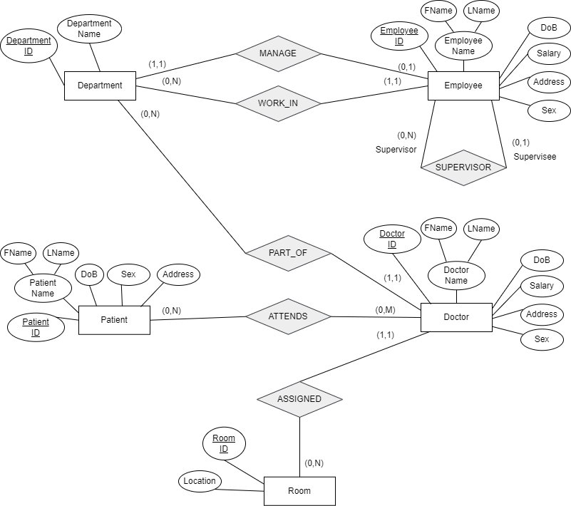
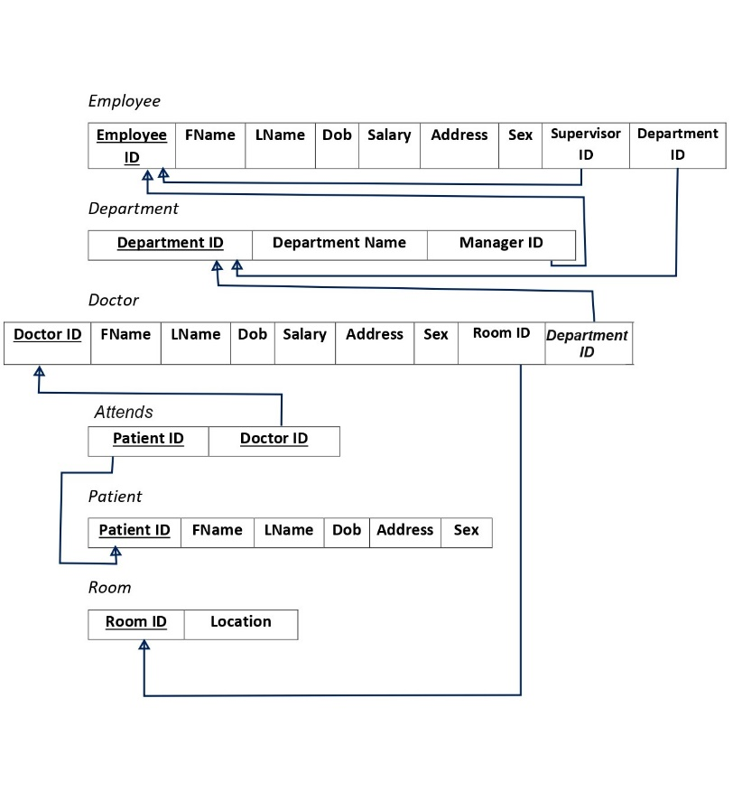
How is implemented?
1

Slide 7
How is implemented? ER Diagram
3

Slide 8

How is implemented? ER Schema
3

Slide 9
Possible queries according to the ER diagram
CREATE VIEW MED_INS as SELECT Doctor_ID, fname, lname from Doctor where department_ID = 2;
SELECT Doctor_ID, Fname, Lname from Doctor;
SELECT * From Employee where sex = ‘Male’;
SELECT Doctor_ID, COUNT(Patient_ID) from Attends Group by Doctor_ID;
SELECT Doctor_ID, Salary from Doctor where Salary > (SELECT AVG(Salary) from Doctor);
SELECT * from Employee where Employee_ID in (select Manager_ID from department);
Select Department_ID from department WHERE department_name = 'Medical Department’;
Select Room_ID from Room minus Select Room_ID from Doctor;
Select Employee_ID, Address from Employee where supervisor_ID is null;
Select D.Doctor_ID, D.Fname, P.Patient_ID, , P.Fname from Doctor D, Patient P where D.Fname = P.Fname;

Slide 10
Implementation of the Schema
CREATE table Department(Department_ID integer constraint D_pk primary key, Department_Name varchar2(25) constraint deptname unique, Manager_ID integer);
CREATE table Employee(Employee_ID integer constraint e_pk primary key, Fname varchar2(15), Lname varchar2(15), Dob date, salary number(8,2), Address varchar2(25), Sex varchar2(7), Supervisor_ID constraint svf references Employee (Employee_ID) on delete set null, Department_ID constraint dif references Department(Department_ID) on delete set null);
ALTER table Department add constraint dc FOREIGN KEY (Manager_ID) references Employee(Employee_ID) on delete set null;
CREATE table Room(Room_ID integer constraint R_pk primary key, Location varchar2(25));
-
-
-

Slide 11
Implementation of the Schema
CREATE table Doctor(Doctor_ID integer constraint Do_pk primary key, Fname varchar2(15), Lname varchar2(15), Dob date, salary number(8,2), Address varchar2(25), Sex varchar2(7), Room_ID constraint rif references Room(Room_ID) on delete set null, Department_ID constraint deptif references Department(Department_ID) on delete set null);
CREATE table Patient(Patient_ID integer constraint Patient_pk primary key, Fname varchar2(15), Lname varchar2(15), Dob date, Address varchar2(25), Sex varchar2(7));
CREATE table Attends(Patient_ID constraint pifk references Patient(Patient_ID) on delete set null, Doctor_ID constraint difk references Doctor(Doctor_ID) on delete set null, constraint Attends_pk primary key (Patient_ID,Doctor_ID));

Slide 12
Filling data into schema (Sample)
INSERT into Department values(1, 'Medical Department', null);
INSERT into Employee values(1, 'Naif', 'Askul', '2-APR-1990', 30000, 'Jeddah,Al Sanabel', 'Male', null, 1);
INSERT into Employee values(2,'Faisal', 'Balamash', '1-MAR-1995', 25000, 'Jeddah,Al Sharafeyah', 'Male', null, 1);
UPDATE Department SET Manager_ID = 1 WHERE Department_ID = 1;
UPDATE Employee SET Supervisor_ID = 2 WHERE Employee_ID = 1;
INSERT into Room values(1,'Floor 2,J1’);

Slide 13
Filling data into schema (Sample)
INSERT into Doctor values(1, 'Zaki', 'Alsubhi', '2-APR-1990', 23000, 'Jeddah,Al Sanabel', 'Male', 1, 1);
INSERT into patient values(1, 'Ahmed', 'AlGhamdi', '2-APR-1990', 'Jeddah,Al Sanabel', 'Male’);
INSERT into Attends values (1,1);

Slide 14
Thank you for listening!

